Slide 1
HOW DOES THIS IMPACT
MY BUSINESS
Making the Business Case for Caregiving Policies

Slide 2

Caregiving is an increasingly prevalent characteristic
of the workforce.
Almost all workers are current or potential caregivers.
1 in 6 workers
currently have
caregiving
responsibilities.
Nearly HALF of workers expect to have elder caregiving responsibilities over the next 5 years.
Notes:
Sources:
1. Bureau of Labor Statistics. (2013). Unpaid Eldercare in the United States—2011-2012 Data from the American Time Use Survey. Retrieved from http://www.bls.gov/news.release/pdf/elcare.pdf
2. Brown, M. (2013). Benefits of an Eldercare-Friendly Workplace. Social Work Today, 13 (1): 32.
3. Feinberg, L., & Choula, R. (2012). Understanding the Impact of Family Caregiving on Work. AARP Public Policy Institute Fact Sheet 271. Retrieved from: www.aarp.org/content/dam/aarp/research/public_policy_institute/ltc/2012/understanding-impact-family-caregiving-work-AARP-ppi-ltc.pdf

Slide 3
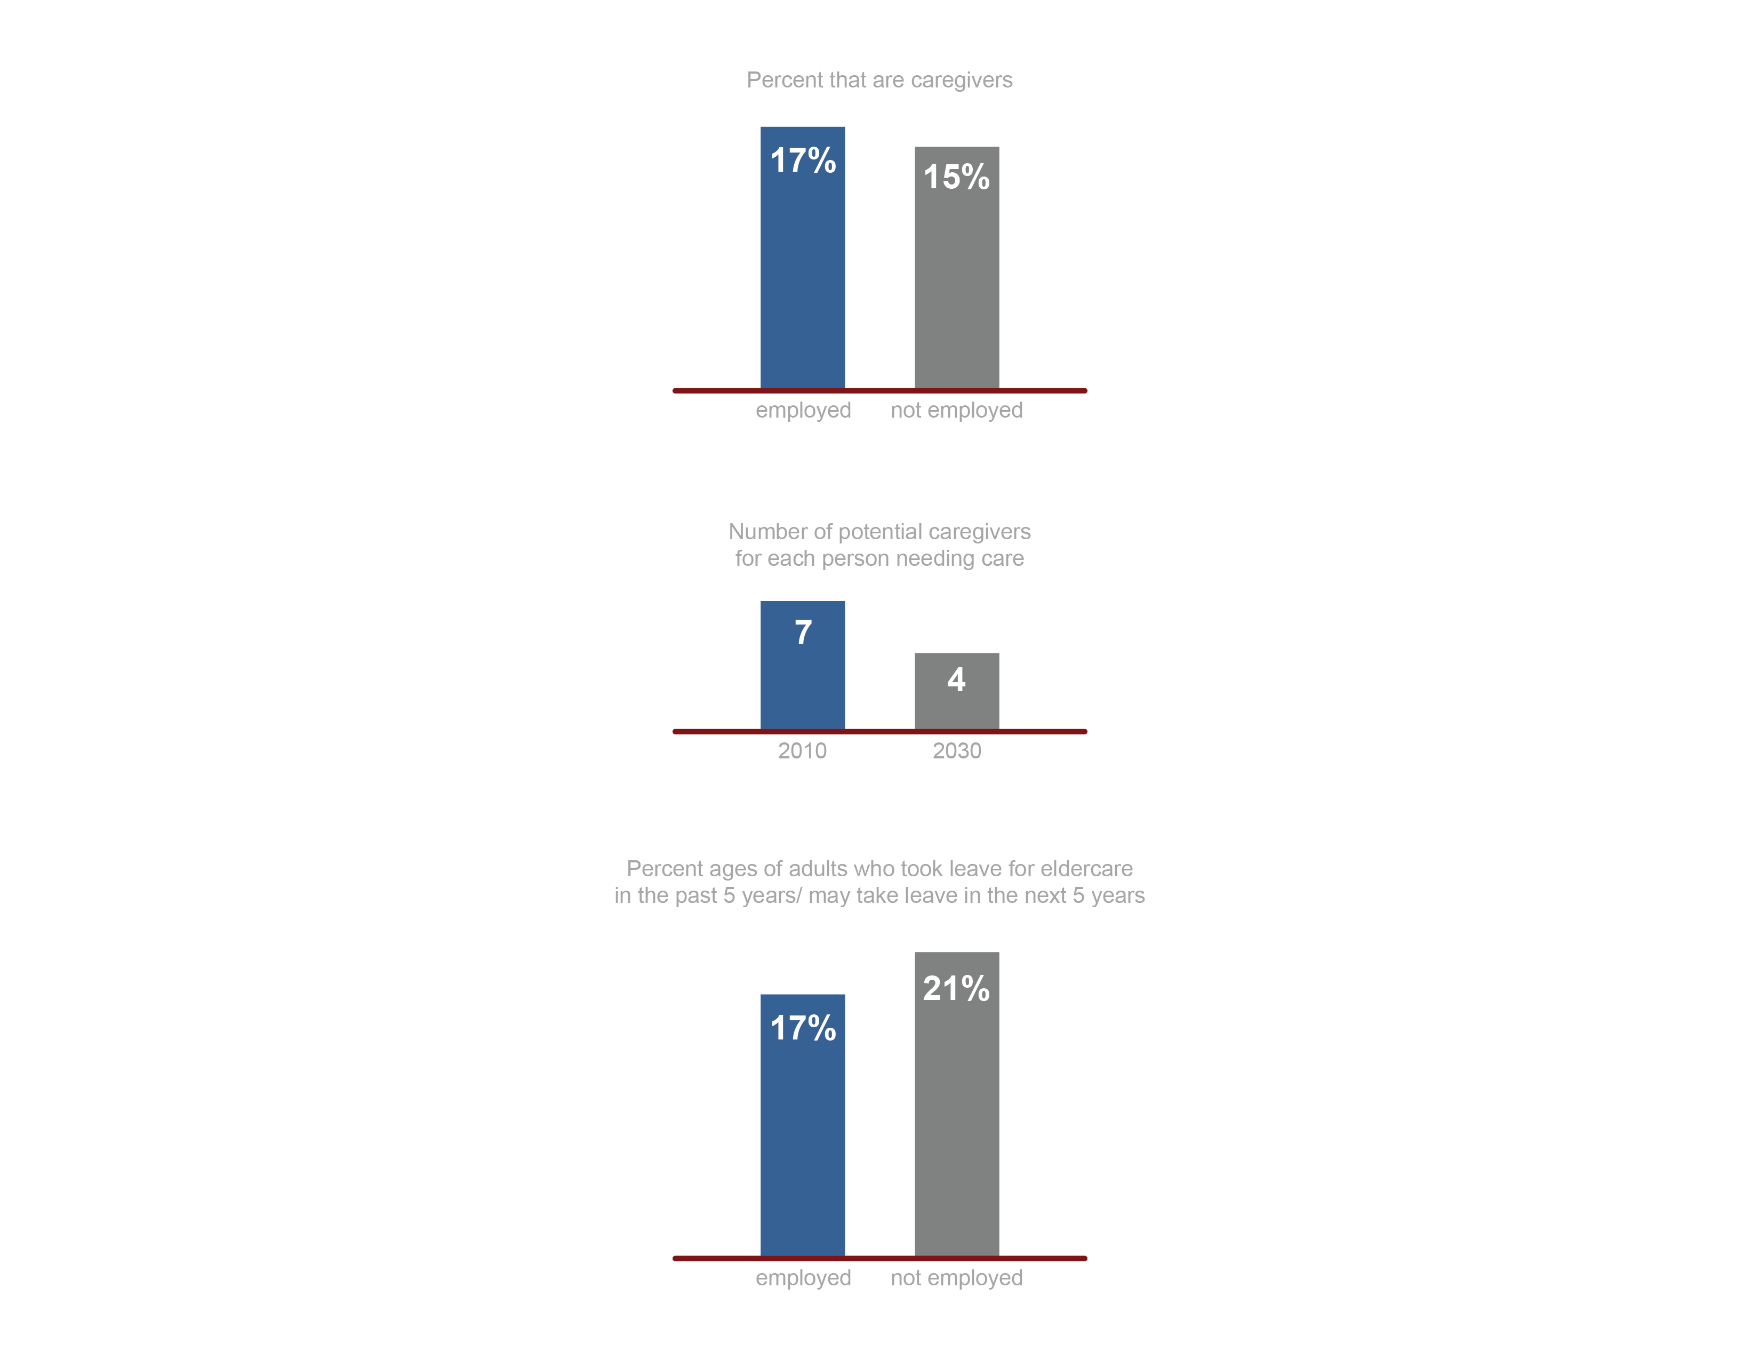
It’s a big issue that will only get bigger
over the next 5 to 15 years.
Employed adults are more likely than the not employed to have caregiving responsibilities.
The number of available caregivers for each person potentially needing care is shrinking as the population ages, increasing the probability that more of your workforce will shoulder these responsibilities.
Without support, about 1 in 5 employed adults may need to leave for caregiving reasons in the next 5 years. That’s a fifth of your workforce.
Notes:
Source: Bureau of Labor Statistics. (2013). Unpaid Eldercare in the United States—2011-2012 Data from the American Time Use Survey. Retrieved from http://www.bls.gov/news.release/pdf/elcare.pdf

Slide 4
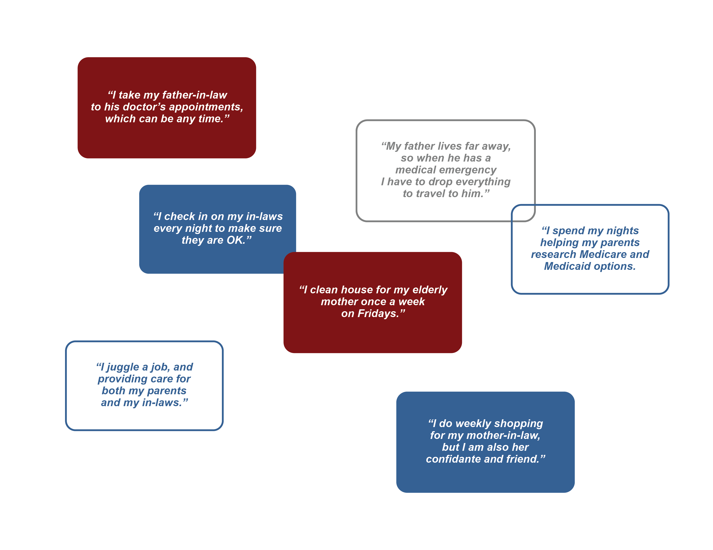
Caregiving situations are diverse. Your existing policies may not work for everyone.
Notes:
Statements are original but are based on the distinctions in: Drentea, P. (2007). Caregiving. In G. Ritzer (Ed.), Blackwell encyclopedia of sociology. Blackwell Publishing. Blackwell Reference Online.

Slide 5
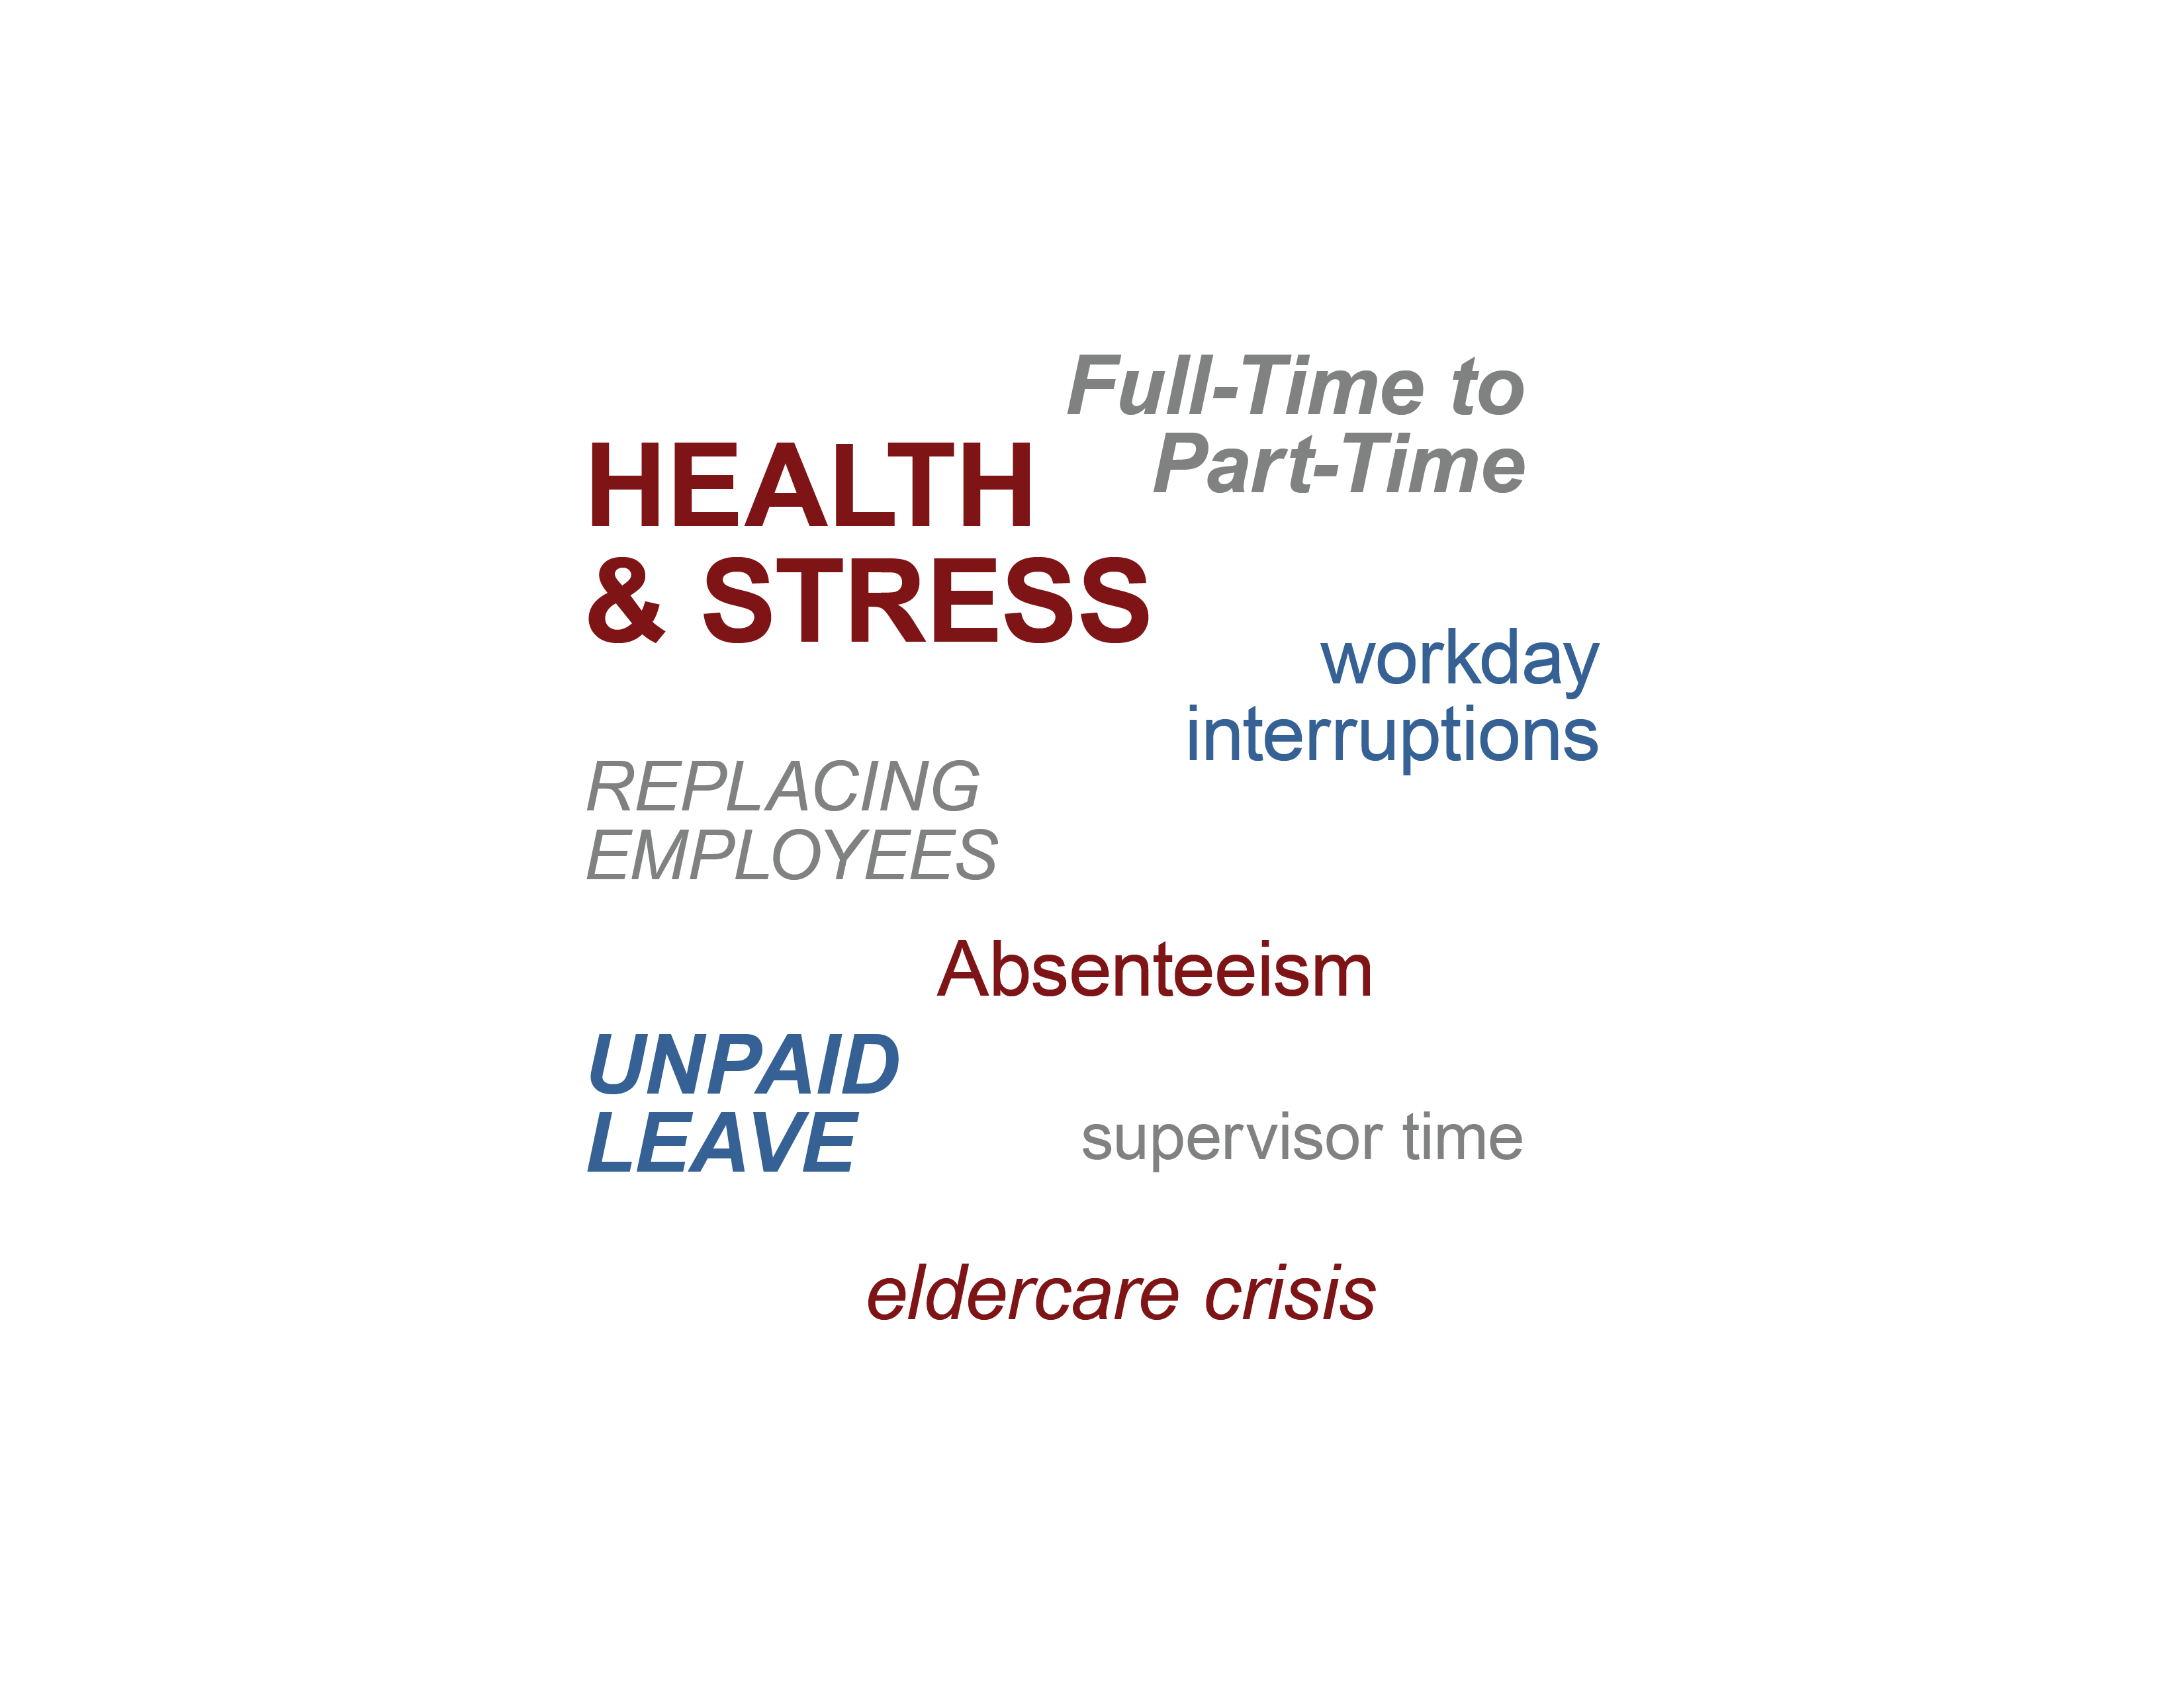
The costs of ignoring eldercare add up…
and some of the biggest costs, such as stress
and employee
engagement, are often ignored.
Add source to slide #5 in the Impact ppt. "Source: The MetLife Caregiving Cost Study: Productivity Losses to U.S. Business (2006) and The MetLife Study of Working Caregivers and Employer Health Care Costs (2010)"
Notes:
Sources: Relative size of text are based on the following sources.
1. AARP Public Policy Institute and National Alliance for Caregiving. (2015). Caregiving in the U.S. 2015. Retrieved from http://www.aarp.org/content/dam/aarp/ppi/2015/caregiving-in-the-united-states-2015-report-revised.pdf
2. MetLife Mature Market Institute & the National Alliance for Caregiving. 2006. The MetLife Caregiving Cost Study:
Productivity Losses to U.S. Business. Retrieved from http://www.caregiving.org/data/Caregiver%20Cost%20Study.pdf
3. MetLife Mature Market Institute, University of Pittsburgh Institute on Aging, and the National Alliance for Caregiving. (2010). The MetLife Study of Working Caregivers and Employer Health Care Costs. Retrieved from https://www.metlife.com/assets/cao/mmi/publications/studies/2010/mmi-working-caregivers-employers-health-care-costs.pdf

Slide 6
Make a connection to the bottom line.
These could be your costs if you don’t support your caregivers. Supporting caregivers can reduce the potential costs.
Health Care
Total Spent
Estimated increase in
health care costs for
employees providing
eldercare, relative
to those who do not:
Estimated direct annual
cost of eldercare to the
employer, per employee
providing intense eldercare,
in 2015 dollars:
8%
$2,490
Notes:
Sources:
1. MetLife Mature Market Institute & the National Alliance for Caregiving. 2006. The MetLife Caregiving Cost Study:
Productivity Losses to U.S. Business. Retrieved from http://www.caregiving.org/data/Caregiver%20Cost%20Study.pdf
2. MetLife Mature Market Institute, University of Pittsburgh Institute on Aging, and the National Alliance for Caregiving. (2010). The MetLife Study of Working Caregivers and Employer Health Care Costs. Retrieved from https://www.metlife.com/assets/cao/mmi/publications/studies/2010/mmi-working-caregivers-employers-health-care-costs.pdf

Slide 7

Here are three ways that caregiving policies
make good sense.
They can reduce costs—such as absenteeism, stress, and turnover, associated with the unmet needs of working caregivers.
They can increase employee engagement and loyalty by showing employees that the organization cares about their well-being.
They can provide evidence to the larger community that the organization is family-friendly.
Notes:
Various sources were used, including several focusing specifically on flexible work options (one form of caregiving policy). Sources include:
1. Feinberg, L., & Choula, R. (2012). Understanding the Impact of Family Caregiving on Work. AARP Public Policy Institute Fact Sheet 271. Retrieved from: www.aarp.org/content/dam/aarp/research/public_policy_institute/ltc/2012/understanding-impact-family-caregiving-work-AARP-ppi-ltc.pdf
2. SHRM Foundation. (2014). Leveraging Workplace Flexibility for engagement and productivity. Retrieved from http://www.shrm.org/about/foundation/products/documents/9-14%20work-flex%20epg-final.pdf
3. SHRM. (2008). Creating a flexible workplace. Retrieved from http://www.shrm.org/education/hreducation/documents/creating%20a%20flexible%20workplace_final.pdf

